Slide 1
An Assessment of Current Straddle Packer Utility
Carl Keller
FLUTe
12/13/2017

Slide 2
Topics of this presentation
Background
  Purpose of hydrologic measurement at contaminated sites
  General concerns with hydrologic measurements
  Common purpose of straddle packer measurements
Flow fields when using packers
General concerns in use of packers
  Head measurements
  Transmissivity measurements
  Contaminant distribution measurements
Evidence for the concerns
Recent alternatives to use of straddle packers
Notes:
Sometimes if one skips the background he assumes too much . This goes from general to specific

Slide 3
Reasons for hydrologic measurements:
Assess the flow paths and conductivity distribution in the formation
Determine the extent of contaminated ground water
Determine the constituents of the contamination
Map the head distribution in the formation. The head controls ground water flows and contaminant flux.
Locate the source of contamination
Predict the migration of contaminants
Design remediation methods to remove or influence contaminant migration subsurface
Monitor natural attenuation.
Notes:
Everyone knows this, but sometimes one forgets. The actual purpose varies from monitoring landfills, municipal water supply assessments to remediation design. I assume mainly the use at contaminated sites.

Slide 4
Challenges with subsurface measurements in general
The drilling process for access to the subsurface disturbs the original state of contaminant distributions
The open borehole allows contaminant migration which can further perturb the natural distribution.
Drilling fluids clog the flow paths frustrating conductivity assessments and preventing access to the natural distribution of contaminants
Various drilling methods provide different degrees of frustration of the assessment of contaminants (worse to better)
  Mud drilling with recirculation and injection of mud to significant distances in the formation
  Core drilling with recirculation of drilling fluids and possible heating of the core,
  Sonic drilling with mechanical and thermal disturbance of the formation and core
  Air drilling with nominal inflow to the borehole rather than out flow to the formation
Chemical alteration of the subsurface environment via the open hole or the contents of the borehole after drilling
Notes:
These affect many kinds of measurements and the extent that they affect specific measurements versus others is important. A method that requires recirculation of the drilling fluid is not desirable nor is a measurement requiring long periods of open hole cross connection desirable. A method that alters the natural state is of more concern than one that does not. A method that does not allow purging of cross connected water is less attractive than one that draws from a useful distance from the borehole. A method that seals the entire borehole to allow the return of the natural state is desirable compared to long open hole times.

Slide 5
Common use of packers
Reduce flow in open boreholes and associated contaminant migration
Isolate an interval of the formation for measurements of
  Head in the straddled interval
  Transmissivity and storativity in the straddled interval
  Contaminant type and concentrations in the interval
  Monitor the water quality and head histories in the formation interval straddled by the packers (e.g., Westbay and other packer multi-level sampling systems)
Isolate intervals of the formation for pumping tests, slug testing, etc…
Isolate intervals of the formation for injection of remediation fluids
Notes:
Packers are seldom left in place due to cost of rental and then usually only one packer. Sometimes several packers seal a single hole.

Slide 6
Why use packers?
A simple concept
Traditional (in use by USGS since 1961 (Jones))
Commonly available
Wide variety of historical hydrologic interpretations using packers
Perception that packer tests are required by the regulators
Notes:
Traditional use is a major factor and lack of alternative methods is perhaps the main reason for use.

Slide 7
Some Problems with Straddle Packer Tests
Expensive procedure and poor spatial resolution (5-20 ft intervals)
To avoid expense, often used to test only high flow zones determined from tele-viewer or flow logs. But, high flow zones may not contain the most contamination.
To avoid expense they are used with longer straddled intervals
They leak giving misleading results
  a. Head measurements are problematic since miniscule flow can change the head
  b. Contaminant distributions are often misleading due to leakage
  c. Transmissivity profiles are more useful, but approximate and affected by leakage
Highly susceptible to the contaminant cross connection during drilling and later flow in the open hole during the packer testing.
Notes:
Throughout this presentation the evidence is described. Some are simple drawings of possible flows. Others are actual experience of the consequences of use of packers and then are described alternatives and relative costs.

Slide 8
Other Problems with straddle packers
They can be trapped by borehole slough
  a. Loss of packers (expensive)
  b. Loss of borehole (very expensive)
They require heavy and expensive equipment while suspended in the borehole especially for large diameter holes.
The measurements do not compare well to long term measurements in sealed boreholes for various reasons:
  a. Short term drilling effects
  b. Leakage from the open borehole above and below the packers
  They are not well purged or too well purged thereby aggravating the leakage
  The wait for equilibration of head was too short.
They are not usually left in the borehole for a long term seal due to expense.

Slide 9
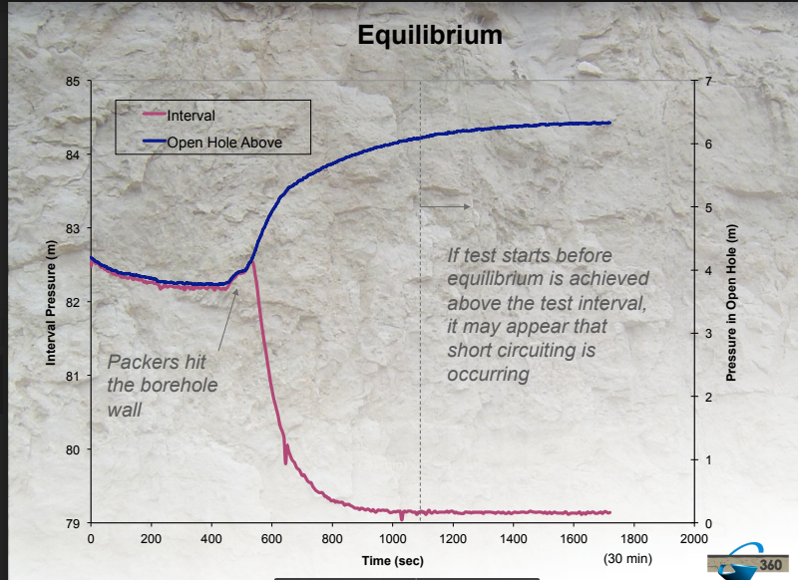
The measured head difference above and below the top packer when the packers are inflated
Such a large head difference of 6m is a challenge of the packer seal.
This measured head difference is taken from Quinn, et al 2013 and is exceptionally large.

Slide 10
One leak path is the seal of packers against the borehole wall
The cored hole is more nearly smooth, but the seal depends upon the state of the packer surface and the packer pressure.
Unfortunately, core holes are 3x the cost of air rotary with more fracture clogging and recirculation of drilling fluids.
The sonic hole may not allow a packer seal
(note the scale)

Slide 11
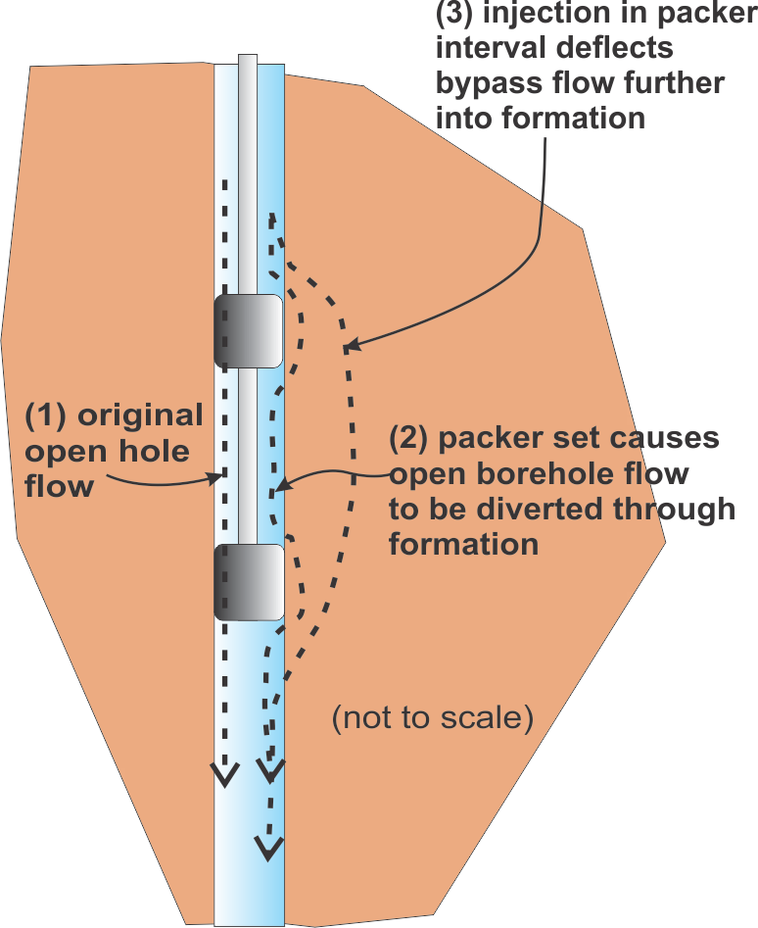
The bypass potential in the formation?
Note the 3 flow paths. 1) the open hole. 2) when the packers are dilated, 3) during the injection into the straddled interval.
This kind of bypass upon inflating the packers can lead to erroneous head measurements in the straddled interval.
Pat Quinn (personal communication) confirmed that the head measured in the straddled interval is usually between the head in the borehole above and below the packers.
Quinn, et al 2016 do not address the change in head above the packer due to the flow path changes from (2) to (3).
The deflection of the flow path from (2) to (3) would usually increase the head above the packers in addition to any head change caused by leakage past the top packer during injection.
Notes:
The flow path (1) is in the open hole before the packers are inflated. Upon inflation of the packers, the blocked open hole flow tends to take the path no. (2). Upon injection in the straddled interval, the bypass flow of the packers (2) is deflected to a longer flow path (3). The longer flow path impedance will result in an increase in the total head difference across the packers as shown in the previous graph. Any head change above the packer would be a combination of the that due to the longer bypass path and that due to leakage past the upper packer. That increase in head above the packer may lead to an over estimate of the leakage as described hereafter.

Slide 12
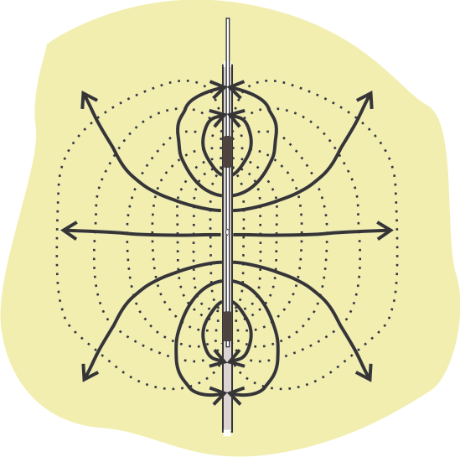
The injection or extraction can communicate with the borehole above or below the straddle packer
A drawing of the flow field for bypass to the open hole during injection into the straddled interval.
This kind of connection to the open hole can perturb a transmissivity (T) measurement
Quinn, et al 2016 addressed the connection to the borehole and the effect on T measured with packers.

Slide 13
Bypass upon extraction of a water sample
This kind of leakage can cause the sampled water to contain contaminants from the open borehole as well as from the formation. (nominal scale of a 2 ft packers in a hole with 8 ft spacing.)
Additional purging does not improve the sample quality if it draws more borehole water.
This kind of leakage will skew the contaminant assessment

Slide 14
What is the evidence of this kind of packer error?
Straddle packer measurements showed significant contaminant levels in intervals which were later sampled by a multi-level system (MLS) using a continuous liner seal which showed non-detect. Examples of where the Water FLUTe MLS showed ND; the packer measurements were: 33-45’, 190ppb; 107-122’, 570 ppb; 229-244’, 330 ppb (personal communication, K. Mishkin, USEPA, as noted at the Mansfield Trail superfund site, hole MLS-1.)
At another Superfund site in NJ:
 | OSW-8 | (relatively low levels)
depths (ft) | 65-75 | 160-170 | 255-265 | 350-360 | 445-455 | 470-480 | 528-543
MLS 9/22-23/17 | 4.2 | 16.0 | 12.0 | 1.6 | 4.0 | 1.1 | 8.6
Packer 8/7/2017 | 6.76 | 8.2 | 34.84 | 16.56 | 10.3 | 12.9 | NA
ratio packer to WF | 1.61 | 0.51 | 2.90 | 10.35 | 2.58 | 11.73

Slide 15
Difference due to packer leakage or cross connection?
Also different
in time of
measurement.
(4 MLS
measurements
over 2 years.)

Slide 16
Westbay packer measurements in Meyer, et al, 2016
Of the 263 measurements,
only the red circled
port’s heads don’t lie
between the head in the borehole above and below.
A test might be to draw a sample and monitor pressure in adjacent intervals, but not possible with this system and not definitive even if done.
If each packer is located in a smooth hole in an aquitard, it should provide a good seal. But where are those conditions?
Notes:
One can not distinguish between vertical communication due to leak from that due to flow in the formation.

Slide 17
The 263 packer measurements shown are only proof of the generalization that the head in the interval usually lies between the head above and below in the open hole
Neither the few exceptions shown in the 263 ports nor the apparent aquitards prove that packers are, or are not, leaking. That is an essential difficulty. The packers may only impede the vertical flow in the open hole.
It is likely that “packers in smooth holes and placed in aquitards are reliable.” (if the packers are not over-pressurized and “splitting” the formation, discussed later)
The normal gradient in the formation would also produce straddled interval heads between the heads above and below the interval in the formation. But not always between the borehole head above and below.
The head measured above the upper packer during injection is usually measured with a low range higher resolution transducer. Below the packers, the transducer must be of much higher range with lower resolution due to the depth of the transducer.
Whereas Quinn, et al 2016 show that the head between a single pair of straddle packers is not the head in the formation, the many packers of the Westbay system should give a better approximation to the head distribution if closely spaced as in Meyer, et al 2016. -but that is a relatively expensive head measurement with possible limitations of contaminant resolution due to packer bypass. It is true that with enough closely spaced packers one can approximate the seal of a continuous liner.
Notes:
In a recent installation of multi level packer system in a 375 ft hole in NJ, ~82% of the borehole was still open with 19 3 ft packers.

Slide 18
Other evidence of packer leakage
Quinn, et al 2016 describe an “overcorrection” when using the measured head increase above or below straddle packer injections to determine the amount of leakage. The leakage estimate uses the head increase and the total transmissivity above the straddled interval. The correction was deemed excessive when the estimated leakage rate exceeded the injection rate between the packers.
The diagram earlier of the bypass of the packers before the injection is started is one explanation of how the measured head above the packer can change during the injection. Of course such a change would also be augmented by the actual leakage in a permeable formation.
Quinn, et al 2016 addresses the corrections for packer leakage to the measured transmissivity. The existence of such leakage is problematic for both contaminant samples and for head measurements with straddle packers.
There is no similar correction for contaminant leakage from the borehole above or below the packers.

Slide 19
The USGS has been diligent in perfecting the straddle packer hardware
The design developed for measurements at the Air Force Plant 6 in Marietta, GA in deep fractured rock may be the state-of-the-art packer system (Open-File report 2008-1349)?
The Plant 6 packer data there does show evidence of leakage. The effect of leakage on contaminant concentrations is not discussed in that report.
The packer water quality results at AF Plant 6 were compared to the contaminant concentrations from passive diffusion bags and to grab samples at the same elevations in the open hole as the packer tests. There was little difference in the concentrations from the three kinds of sampling devices. If the open hole is cross connecting to the formation, there would be no difference.
They recommend purging 3 volumes from the straddled interval.
Vertical gradients were large enough for substantial vertical flow in the open holes. Note, the three comparison measurements were all done in open boreholes.
However, a subsequent USGS report (Open-File report 00-277) shows the contaminant measurements in the open holes down gradient from the Plant 6 site to be different from the formation contamination due to flow in the open holes.
Notes:
Whereas the packer design may be well considered, the cross connection in the open hole makes the straddle packer measurement weakly related to the contamination in the formation without the open hole.

Slide 20
Other references to packer leakage
Molz, et al 2000 in an EPA report address packer leakage with cautions about monitoring head above and below the packers. He says that without detailed information on the total transmissivity above and below the packers the head change can be misleading. They recommend guard packers to help the monitoring of leakage.
Maliva, et al 2012, “Leakage around the packer, and thus production of spurious data, is an important concern for packer tests.”

Slide 21
Additional perturbations of packer testing
If the packer bladder pressure exceeds the minimum horizontal stress in fractured rock, a vertical fracture can open to flow bypassing the packer.
In basin and range geologic situations, the horizontal stress can be much less than half the vertical load. Increasing the packer pressure to improve the seal against the hole wall has limits.
The temptation to pump more to purge the earlier cross connected flow can enhance the leakage flow from the open hole above and below the packers. In some high flow holes (as on the next slide), the volume cross connected can not be reasonably removed. One needs an estimate of that flow.

Slide 22
Time dependent contaminant levels
After sealing the 94BR borehole with a liner with 10 ports, the water samples showed a major change in contaminants.
The open borehole was flowing 10 hole volumes per day from above 70 ft to below 70 ft bgs.
Packer testing in the open borehole would not have removed the 2250 gals of water flowing into the lower half of the borehole each day that the hole was open.
The packer tests provide at best only a snapshot of the current contaminant distribution with the borehole open.
Notes:
The first MLS measurement in a sealed borehole was only a day after installation. Four months later the measured level is nearly 3 times higher and then settled to a near constant level of twice the initial value. What would be the contaminant concentration with the open flowing borehole during packer testing? Perhaps even lower yet due to open hole low concentrations.

Slide 23
Advantages of Packer tests?
Measurement of very low T intervals below the resolution of other methods (best done with guard packers, to assess leakage and over long intervals. Commonly done in radioactive waste repository assessments)
Measurements in boreholes with extreme gradients which would be damaging to flexible liner methods.
Commonly available from many drillers.
Can be performed in the vadose zone with water or air, still with same problems.
In extreme artesian conditions (FLUTe T profiles have been measured with 30 ft artesian heads but are not practical for higher artesian heads)
Packer tests can be done easily at different head and flow rates to assure they are within the assumptions of the common Thiem equation used, but that greatly prolongs the time required to perform the measurements.
Notes:
However, many of these advantages are not needed at contaminant site characterizations

Slide 24
With the uncertainties of straddle packer testing, what are the alternatives?
Use MLS systems instead of packers. But, that is best done with a knowledge of the hydrologic and contaminant state to locate the optimum sampling intervals. T data is lacking from most MLS systems.
Use flow meters to identify the flow zones, but without head or T data except as suggested by Palliet, 1998 and Palliet, et al 2000. Flow meter estimates have iteration uncertainties. The spatial resolution is not usually good. Often >10 ft.
Use passive diffusion bags or low flow sampling in open holes? These lack head data or transmissivity information and can be very misleading due to vertical flow in the open holes. The spatial resolution is also usually poor. And, the open hole allows contaminant migration.
Use the FLUTe methods of measurement described on the following slides

Slide 25
The lack of alternatives may be the main reason for past straddle packer use.
FLUTe measurements only became an option as follows:
  2004, High resolution transmissivity measurements with everting liners (the FLUTe transmissivity profile).
  2010, head profiling using the transmissivity profile data (“Reverse Head Profile”).
  2010, the activated carbon technique for mapping the dissolved phase associated with the NAPL FLUTe mapping method (NAPL/FACT)
  2015, the Shallow Water FLUTe system for less expensive multi-level sampling in a liner sealed borehole.
Extensive validation of the FLUTe liner measurements was available in 2016. Multiple peer reviewed papers now treat these methods

Slide 26
Alternatives to the packer H(z), T (z) and C(z) measurements
The FLUTe NAPL/FACT seals the borehole and provides NAPL distribution and dissolved phase distribution of contaminants on the 0.5-3 ft scale.
The FLUTe transmissivity profile with a flexible liner providing half foot resolution (Keller, et al 2014)
FLUTe “Reverse Head Profile” with 10-20 ft resolution (Keller et al, 2016)
Water FLUTe (Cherry, et al 2007) and Shallow Water FLUTe MLS’s for long term head and water quality monitoring
Geophysics (Tele-viewers for fracture and geology identification, plus flow meter and caliper) to confirm FLUTe Head and Transmissivity measurements.
Note, the FLUTe methods are patented.
Notes:
H(z) is the vertical head distribution, T(z) is the vertical transmissivity distribution, and C(z) is the vertical contaminant distribution.

Slide 27
Example of FACT results at NAWC 94BR
FACT (FLUTe Activated Carbon Technique) results with 6” resolution show the same distribution of contamination as water samples 1 year and 2 years later.
The FACT measurements were installed relatively shortly after the borehole was drilled.
The water quality samples were obtained using the Shallow Water FLUTe MLS system over the 2 years.
Notes:
The red squares are FACT 6 inch samples. The black bars are the sampling intervals of the SWF. The blue triangles are measurements a year later.
Considering that the FACT system was left in place for 2 weeks, but not long after the hole was drilled, the agreement with the water samples 2 years later is surprising.
Note the extreme level of the water sample at 115 ft at 10% of the TCE solution limit. Yet the only small DNAPL stain was at 42 ft.

Slide 28
Example of a transmissivity measurement in <1 hr.
(not counting setup and break-down)
Transmissivity was measured with a
flexible FLUTe liner every half
second providing 6600 data points.
The data are integrated over every foot
to produce the equivalent of 150 one foot straddle packer tests.
A 30 straddle packer test series over 5 ft intervals would take ~3 days with probable leakage effects.
Notes:
The spatial resolution is exceptional and the short time of the measurements makes it a very economical alternative to straddle packer testing.

Slide 29
Relative cost of packer testing vs. the FLUTe sequence.
Packer tests were done over 8 days at the Chemsol site in 2017 ($65,000 for two 550 ft holes using 10 ft packer intervals, with 6-8 water samples in each hole.
A NAPL/FACT profile quote for the same site is $56,340.
The FLUTe series provides a much higher resolution result (head intervals excepted).
Note half the FLUTe series cost is analysis of 350 samples with 3’ resolution.
Notes:
Every 3 ft interval of the FACT can be analyzed for the higher resolution of the contaminants.

Slide 30
FLUTe sequence difference from packer testing at the comparison site per borehole
Open borehole time of 1.5 day versus 4 days of packer tests
No misleading results due to leakage to or from the open hole.
No hazard of borehole collapse
Far better contaminant mapping
Actual fracture identification
Much less time/expense needed for contractor oversight
FACT measurement performed in sealed hole over 2 weeks.

Slide 31
Conclusions:
Packer testing is more expensive than methods producing much better information.
Packer testing provides much more coarse resolution data.
Packer testing can provide misleading results in head, transmissivity and contaminant distribution due to leakage.
Packer testing risks hole collapse and expensive loss of hole and/or packers
Packer testing is done in an open borehole over a long time during which cross connection is occuring.
Packer tests provide only the current hydrologic/contaminant condition. That is true of FLUTe FACT measurements, but long term water samples after 2 years were the same as the FACT distribution.
Packer testing is a simple method with a long history of use. Now better methods are available.
Notes:
Several environmental contractors have expressed that they no longer use packers or they only consider them as screening measurements.

Slide 32
Additional information is available:
Collection of experience with packer leakage in the community (e.g. head data compared with sealed well data, contaminant levels with MLS samples)
More comparisons of costs and experience for jobs of varying complexity.
Estimate of the cost of misleading data (e.g., depth of actual contamination in the formation).
Compare the actual quotes for core plus packer testing as proposed at the USACE Bangor site to the cost using the FLUTe sequence instead. The price difference was $800,000?
Cost advantages of high resolution data for remediation design?

Slide 33
Questions and comments are welcome
Frequently asked questions:
Do regulators require packer tests? Are they aware of the alternatives? Often they are not.
What are the actual prices for packer measurements
  With water sample analysis
  Head only,
  T only?
Do consultants require the drillers to not recirculate the drilling fluids, …….?
Are the drilling fluids sampled for contaminants? When recirculating? They should.
What are the equilibrium requirements on packer testing? We find the times can be quite long.
What is the appropriate purge volume for packer testing? Three interval volumes is not enough!
Are all packer tests associated with estimates of leakage based on pressure changes above and below? Are they reported?
How many packer tests are done with guard packers? Very few?
What is a desirable straddled interval?
Are all packer tests aimed at high flow zones? Is that where the contamination resides? No.
Are any packer tests done in sonic holes? Liners seal better on rough hole walls.
Are packer tests only done in well developed boreholes? Required?
When are FLUTe methods not a good alternative?

Slide 34
References:
Cherry, J. A., Parker, B. L. and C. Keller, “A new depth-discrete multilevel monitoring approach for fractured rock,” Ground Water Monitoring and Remediation, vol. 27, no. 2, pp. 57-70, 2007.
Jones, P.H., 1961, Hydrology of waste disposal, National Reactor Testing Station, Idaho, an interim report: U.S. Geological Survey Report IDO-22042, Idaho Falls, Idaho, 82 p.
Keller, C.E., “A New Rapid Method for Measuring the Vertical Head Profile,” Groundwater, Sept. 2016 DOI: 10.1111/gwat.12455
Keller, C. E., J. A. Cherry, B. L. Parker, “New Method for Continuous Transmissivity Profiling in Fractured Rock,”, Groundwater, 52(3), 352-367, 2014.
Meyer, J. R., Parker, B. L., Arnaud, E., Runkel, A. C., “Combining High Resolution Vertical Gradients and Sequence Stratigraphy to Delineate Hydrogeologic 1 Units for a Contaminated Sedimentary Rock Aquifer System Journal of Hydrology,” Journal of Hydrology, Volume 534, March 2016, Pages 505-523
Molz, F., O. Guven, and J. Melville. 2000, MEASUREMENT OF HYDRAULIC CONDUCTIVITY DISTRIBUTIONS: A MANUAL OF PRACTICE, U.S. Environmental Protection Agency, Washington, D.C., EPA/600/8-90/046.
Maliva, R, and T. Missimer, Arid Lands Water Evaluation and Management, Springer Science, June 9, 2012
Paillet, F.L. 1998. Flow Modeling and Permeability Estimation using Borehole Flow Logs in Heterogeneous Fractured Formations, Water Resources Research, 34, 997-1010.
Quinn, P.; Cherry, J.; Parker, B.; “The Use of Straddle Packer Testing to
Hydraulically Characterize Rock Boreholes for Contaminant Transport Studies” Presentation for the Solinst Symposium November 7, 2013
Quinn, P., Parker, B. L. ,Cherry, J. A., “Blended Head Analyses to Reduce Uncertainty in Packer Testing in Fractured-rock Boreholes” Hydrogeology Journal, (2016) 24:59–77. DOI 10.1007/s10040-015-1326-2

Slide 35
Explaining the estimate of leakage with transducer measurements
If the leakage rate Q_{L} past the upper packer is defined as:
Q_{L} = Ta ΔP 2π/ln(R), where Ta is the measured transmissivity in the entire borehole above the upper packer and ΔP is the change in pressure measured by a transducer above the packer during the injection, R is the usual ratio of range of ambient head over radius of the hole.
Q_{L} /Qt, is the ratio of the flow estimate due to leakage divided by the total flow rate of the injection, Qt.
If Q_{L} /Qt calculated is > 1.0, the leakage rate is greater than the flow rate injected! This is the problem possible with the scenario offered in the earlier slide titled “The formation seal problem as inferred from measurements:” because the ΔP measured upon injection is not entirely due to the leakage of injected fluid, but includes the change due to rerouting of the bypass of the entire straddle packer pair in the formation.
Also, if Ta is very large (1-100 cm²/s), ΔP must exceed the transducer resolution to detect a leak. For a 100m transducer at .01% FS resolution limit, and a Ta of 2 cm²/s, the pressure resolution limit of 1 cm implies a leak rate resolution limit 2 cc/s or 120 cc/min. or 1200 cc/10 min. of testing. Since the time to equilibrium can be longer than that, the leak rate is difficult to detect unless Ta is very low or the transducer has a higher resolution.
Notes:
You know something is wrong when the leakage estimate exceeds the injection rate. The probable cause is the pressure rise due to the deflected flow path no. 3 of the earlier illustration .

Slide 36
packer results compared to liner results
The FLUTe T profile was done twice in the same day. The packer tests took several days at different flow rates suggesting the difference was due to nonlinear flow. However the high flow zones are obvious.
Notes:
Results from comparison at Guelph Tool site ~2006 taken from 2007 presentation in Portland, ME at NGWA conference. The packer results are higher where measuring in the laminar flow regime of the Thiem equation. The error is about 50% lower for the FLUTe T profile probably due to turbulence as measured by Quinn. The packer tests were done at several flow rates over several days and they can determine at what flow rates the results are nonlinear. The FLUTe measurement took several hours at the nominal steady state flow for each interval.

