Slide 1
Overview of the FACT Method for a Continuous Profile of Dissolved Phase Contaminant Distribution in Fractured Rock
By
Carl Keller, Beth Parker, Steven Chapman, and Seth Pitkin

Slide 2
Topics
History and Purpose of the method
Method description
Site characteristics and sequence of measurements
Results at NAWC site in a single borehole
Discussion of potential perturbations
Conclusions

Slide 3
Brief History of FACT (FLUTe Activated Carbon Technique)
Current design conceived in 2006 and patented by FLUTe, but first absorbent coverings on flexible liners were sold to LLNL in 1991 for mapping tritiated water.
First FACT system was tested in Denmark in 2010 by NIRAS at the invitation of Anders Christensen under a commercial drycleaner building in the vadose zone.
Subsequent extensive testing performed by the Danish Technical University in the saturated zone
Extensive recent testing at the Naval Air Weapons Center (NAWC) site near Trenton NJ in 2016 – 2017, is reported hereafter.
Recent additional use has occurred in many boreholes
Notes:
The first use of an absorber on a liner was in 1991, 26 years ago. When Anders Christensen suggested our first test of the FACT be in Denmark, I was surprised. It worked very well. Thereafter Mette Brohollm at the DTU and her grad students performed a series of tests addressing many of the obvious questions of the method. 26 installations have been done since June 2017.

Slide 4
The purpose of the FACT :
Overcomes the limitation of the NAPL FLUTe’s mapping of only the pure product
Map the distribution of contamination in the formation with high resolution in a cost efficient manner.
To produce a replica of the dissolved phase of the contamination using the advantages of a sealing liner to isolate the measurement
To collect the contaminants from both the pore space and fracture flows in a sealed borehole
To obtain a spatial resolution better than traditional water sampling or core measurements, and to overcome the problem of straddle packer leakage

Slide 5
The FACT adsorbes the dissolved phase from fractures and the pore space.
The contaminants diffuse into a continuous activated carbon felt strip which is recovered by inverting the liner.
The FACT is usually left in place for up to two weeks due to the slow diffusion rate of chlorinated solvents in water. Less exposure time needed for the vadose zone.
The FACT provides a continuous replica of contamination in pores and fractures
The carbon felt is well isolated from the liner and its interior fluid by a diffusion barrier.
Usually as combined with the NAPL FLUTe, the NAPL and the dissolved phase are both mapped throughout the entire borehole at the same time.

Slide 6
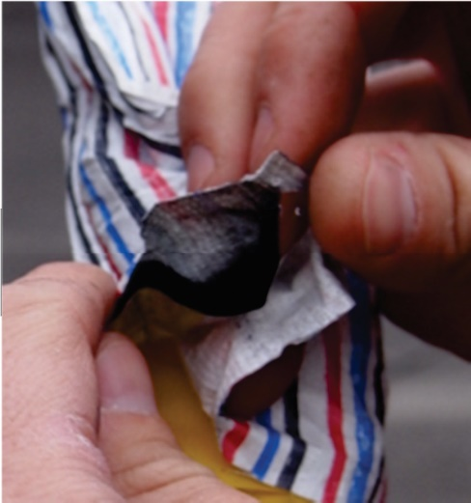
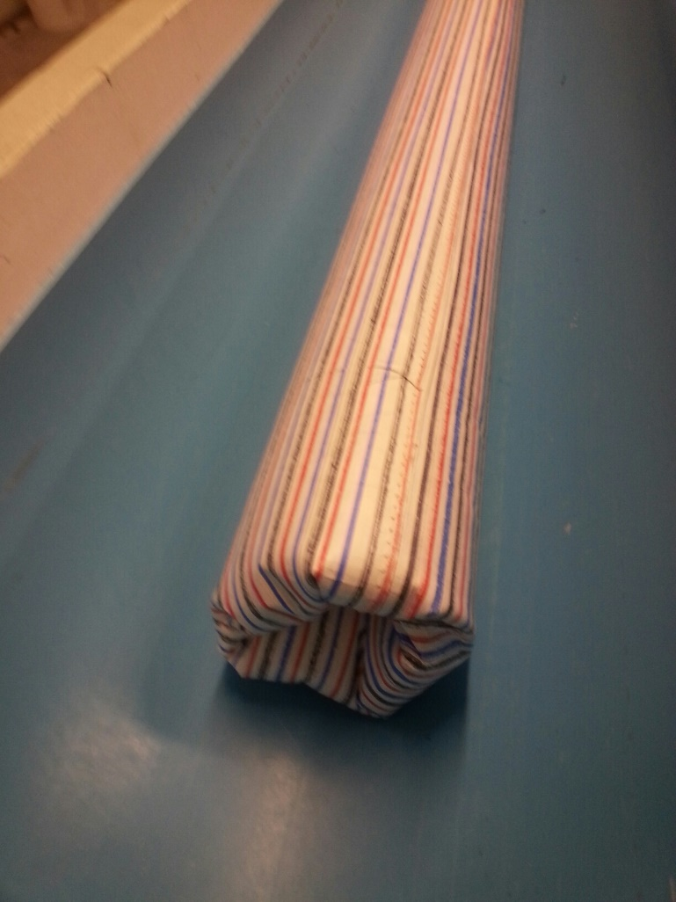
The design
Carbon felt attached
Inside NAPL cover
Dye stripped
NAPL cover
on a liner
Notes:
The activated carbon felt strip is pressed against the borehole to wick by diffusion the contaminants from the pore space of the matrix and from the fractures. After 2 weeks the system is inverted from the borehole and the FACT is separated form the NAPL cover and sent to the lab for analysis of the contaminants by species and amount.

Slide 7
The liner is emplaced from a shipping reel at the well head by eversion and recovered by inversion

Slide 8
This is the “eversion” process

Slide 12
Note: the everting liner displaces the borehole water into the formation as it seals the flow zones

Slide 14
Fully installed, the liner seals the entire borehole.

Slide 15
Note the stepwise inversion
procedure for removal

Slide 19
Upon removal by inversion, the liner draws water into the borehole

Slide 22
How does the carbon work?
The activated carbon felt is emplaced against the borehole wall. The carbon is a very reactive and adsorbent medium
The contaminant migrates from the pore space by diffusion into the carbon which depresses the contaminant gradient in the borehole wall slowing the diffusion process over time.
The diffusion rate depends on the porosity of the formation. The effective diffusion coefficient for the NAWC site is 0.1-2 e-07 cm²/s according to the relationship D_{eff} = D ε^{1.7} Where ε is the porosity of the formation and D is the diffusion coefficient in water. The porosity of the NAWC material is ~6-9%.
For flowing fracture fluids against the carbon, the gradient in the fracture is not depressed in time. This maintains a steep gradient and supports a more rapid diffusion into the carbon. In a sense, the porosity of a fracture is 100%.

Slide 23
The FACT results described hereafter were obtained in borehole 94BR at the Naval Air Weapons Center (NAWC)
The NAWC site is near Trenton New Jersey
The formation is a mudstone, shale, sandstone sequence of steeply dipping beds
The contaminant is TCE
The water table is ~10 ft BGS
The borehole was cased to ~38 ft. and drilled with an HQ core bit to ~3.78” diameter to 150 ft
The core drilling progressed over three days with recirculation of the drilling fluid (a normal procedure) and with the rods left in the hole each night.

Slide 24
The sequence of activities was:
Drilling of the borehole
Geophysical measurements in the open hole.
NAPL/FACT first installation with removal two weeks later.
The FACT was sectioned into 0.167 ft. segments on 0.5 ft spacing for analysis (not the recommended procedure).
FLUTe transmissivity profile was performed using the same liner.
FLUTe Reverse Head Profile (RHP) was performed using the same liner.
Second NAPL/FACT installed and removal two weeks later with the entire carbon felt divided into 0.5 ft segments for analysis (this is the result provided hereafter).
Various other measurements in the open or sealed borehole
10 port Shallow Water FLUTe (SWF) installed with sampling episodes and head measurements over 22 month period

Slide 25
FACT results in 94BR
Left in place for 2 weeks
Continuously sectioned into 6 inch lengths
Analyzed with methanol extraction of VOCs
There are no non-detects
Ft BGS

Slide 26
Reasonable concerns about cross connection effects:
Cross connection to the borehole wall/formation due to drilling fluids?
Cross connection to borehole wall pore space and fractures while borehole was open?
DNAPL migration in the open hole?
Exposure of carbon to borehole water during emplacement by eversion through the borehole water?
Contribution to the carbon by water trapped between the hole wall and the liner due to the rough hole wall and enlargements?
Loss of TCE from carbon during handling on the surface after the carbon is removed from the borehole?

Slide 27
1. Cross connection to pore space and fractures during the drilling process?
Since no samples were collected of the drilling fluid, it is not known to what extent that was a probable source. Such sampling is recommended.
The effect of the drilling fluid circulation could be a relatively uniform background level in the FACT.
Since there were no NDs in the samples and the base level background was ~ 100 μg/g, that could be due to the drilling fluids
Obviously a drilling method that does not recirculate the drilling fluid such as air rotary or air hammer should produce less cross connection.

Slide 28
2. Cross connection to borehole wall pore space and fractures while borehole was open?
Same possible effect as drilling fluids, but no borehole water samples were collected. Such sampling should be done to evaluate the borehole water concentrations.
A diffusion calculation of the contaminant migration into the borehole wall for the time exposed was done using the probable concentrations from the inflow region in the upper half of the borehole and measured water concentrations in that interval. That borehole water level was ~5000 μg/l.
The borehole was open ~1.7 days after drilling. The following plot shows the contaminant gain in the hole wall over 1.7 days and the contaminant decline when exposed to the carbon. The difference between the 1.7 day total contaminant gain in the hole wall and the residual after the carbon is removed is the estimate of the contaminant adsorbed in the carbon.

Slide 29
A calculation of the borehole water TCE diffusion into the hole wall and then out into the carbon
The diffusion from the borehole water at 5,000 μg/l led to the black curve distribution in the hole wall after 1.7 days (not including drilling time).
The subsequent carbon adsorption from the hole wall produced the other distributions over 15 days.
The result was only 7.2 μg/g of carbon, far below the apparent background of ~100 μg/g.
However, if the drilling time were included, the level would be more than 7.2 μg/g

Slide 30
3. DNAPL migration in the open hole?
The first NAPL/FACT showed a dime sized stain at ~40 ft after two weeks. No other DNAPL stains were seen.
The second NAPL/FACT installed showed no DNAPL stains.
High concentrations were seen at similar levels in a nearby hole
Confirmation of the high levels by the water samples over a two year period after the hole was sealed does not suggest cross connection.
The conclusion is that the high concentrations in the bottom of the borehole were not due to DNAPL migration in the open hole.

Slide 31
4. Exposure of carbon to borehole water during emplacement by eversion through the borehole water?
The time of exposure during the motion from the inverted state to the everted state against the borehole wall for the measured liner descent rate is ~2 seconds. -A very short exposure compared to the two weeks in place in the borehole.
The borehole water levels were relatively low and uniform due to the high downward flow rate from the upper inflow portion of the hole (~10 borehole volumes per day).
The eversion at most would provide a very small uniform background contribution to the carbon.
( Note, the borehole flow conditions were deduced from the T profile, the head profile and the water sampling results.)

Slide 32
5. Contribution to the carbon by water trapped between the hole wall and the liner due to the rough hole wall and enlargements?
A calculation was done using the caliper log and a reasonable drape calculation of the liner over the high points on the hole wall (a smoothed version of the high points) to estimate the volume of the water trapped between the liner and the hole wall depressions.
The entire contents of the trapped water were presumed to have been adsorbed in the carbon
The trapped water contribution is plotted against the actual carbon levels, shown next.

Slide 33
The trapped water maximum contribution compared to the actual carbon levels with depth in the borehole
The trapped water contribution (in blue) should be subtracted from the carbon levels (red), but it is only significant in the occasional extreme enlargements of the borehole.

Slide 34
6. Loss of TCE from carbon during handling on the surface after the carbon is removed from the borehole?
The Danish Technical University masters thesis work by Monique Beyer showed that in two days of open air exposure the carbon can lose 50% of the TCE
In two days in DI water, the carbon suffered no detectable loss.
The exposure to air, during the sectioning after the diffusion barrier was removed, is less than ~ 0. 05 days.
There should be no significant loss from the carbon and any loss should be similar for the many samples with minimum effect on the relative distribution in the carbon.
Note, the relative distribution of contamination with depth is the objective of the method.

Slide 35
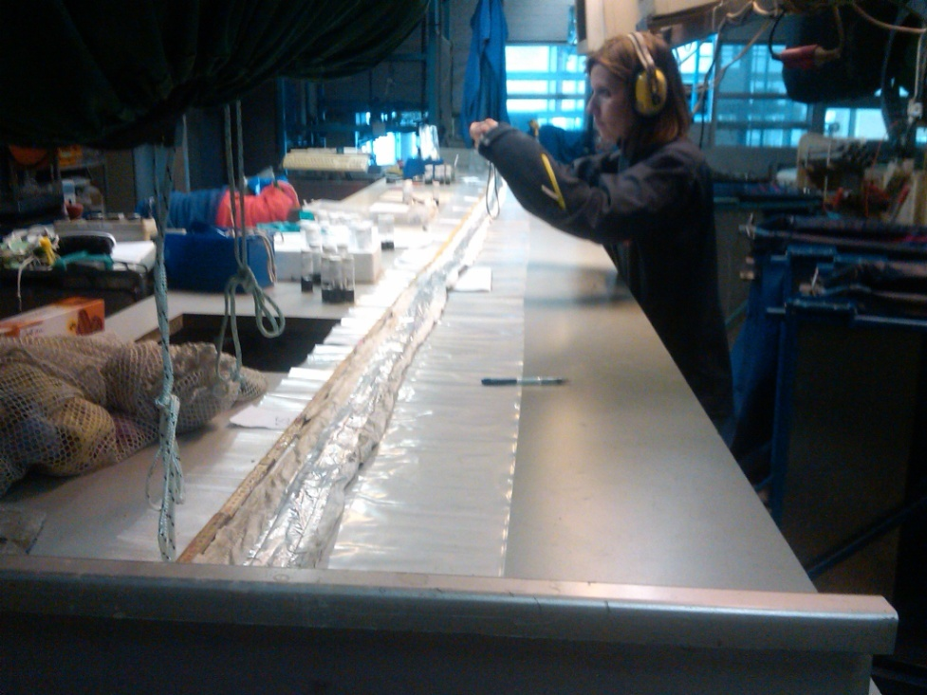
The activated carbon felt also maps the vapor and dissolved phase in the vadose zone
MIP profiles
Inverted cover showing
silver diffusion barrier
Circumstances of FACT:
Direct push installation to 8 M
in unsaturated clay till in Denmark.
Left in place one day.
Mass spectrometer assessment
of carbon felt.

Slide 36
In conclusion, the several potential perturbations were found to be relatively benign compared to the peak levels:
The drilling method used should be selected to minimize the cross connection. Sampling of the drill water is suggested and also grab samples in the open hole.
Cross connection from the borehole water in the pore space is small and slow compared to flow into fractures
Only the trapped water calculation is recommended to assess the potential effect.

Slide 37
The FACT comparison with the water samples from the Shallow Water FLUTe were revealing
The FACT distribution matches very well the long term water samples from the continuously sealed borehole.
Therefore, one must conclude that the FACT is very sensitive to the fracture flows.
The agreement of the FACT distribution with water samples collected over 23 months suggests the FACT is able to assess the natural distribution ( Note, the Aug. sampling used simultaneous purging)
Notes:
The samples collected 10 months later and 23 months later show the FACT was measuring the natural distribution of the TCE in the formation. P&T variations produce some fluctuations in the concentrations. It is surprising that one can plot the FACT results in micrograms/gram on the same linear plot at the water values in micrograms/liter.

Slide 38
highest concentrations were not in the high flow zones

Slide 39
Calculated flow into and out of borehole using Reverse Head Profile and transmissivity profile
The flow into the borehole
was above 70 ft.
That flow based on the water samples was ~5000 μg/l
The outflow is mainly below 80 ft with a vertical flow of about 10 borehole volumes per day

Slide 40
The comparison with the core was somewhat surprising:
The distributions are quite different
One reason for the difference is that the core measurements do not include the fracture water measurements, nor DNAPL in the fractures.
The core is a measurement of the concentration at the moment. The carbon integrates in time. The diffusion gradient is steepest with the fracture water.
There is still a debate about the reason for the low levels in the core below 110 ft. The FACT may be most sensitive to the fracture water.
Most peaks in the core are matched by peaks in the FACT. But not vice versa.
The 10 hole volume flow/day at 3000-5000 μg/l does not cause the 30,000-100,000 μg/l water samples seen in the high FACT intervals.

Slide 41
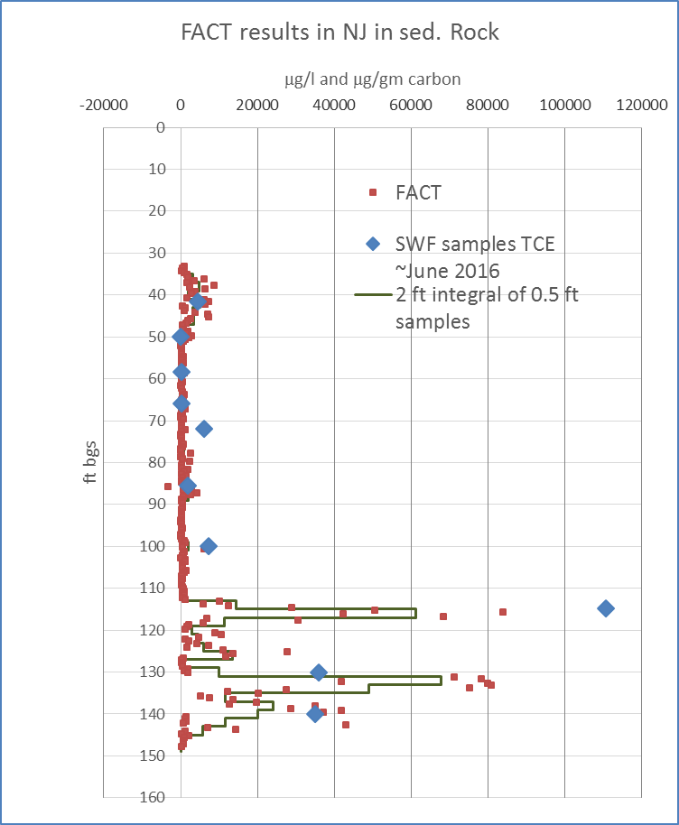
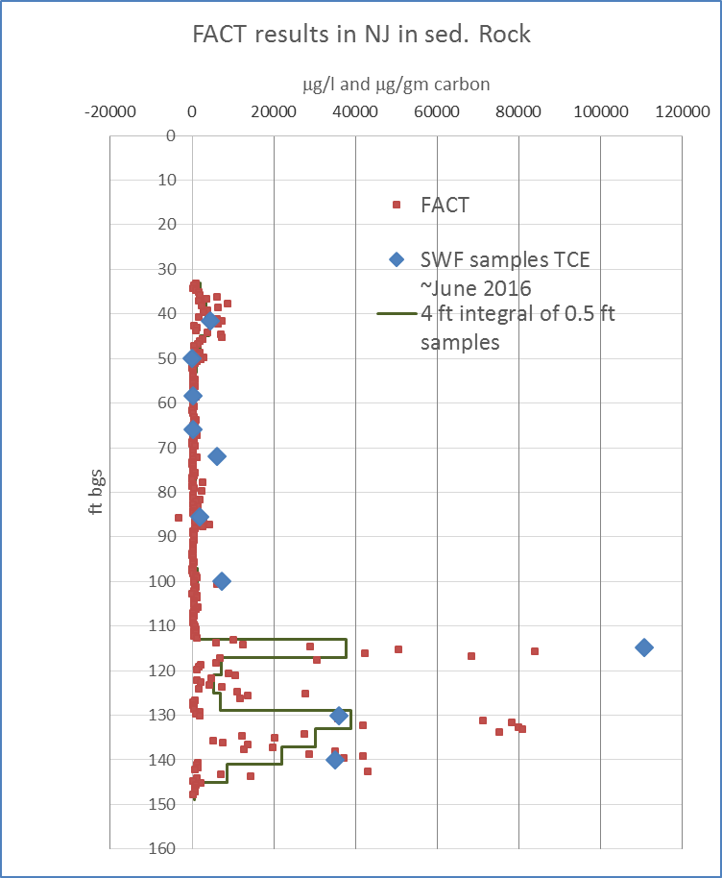
Resolution difference of 0.5 ft to 2 ft to 4 ft samples
red squares are 6” samples
Black graph is integral of 6 inch samples over larger increments
Larger increments miss some hot spots (e.g., 126 and 36 ft)
2 ft samples
4 ft samples
FACT sample beneath SWF pt.
Notes:
The red data points are the FACT half foot long samples analyzed. When averaged over 2 ft and 4 ft intervals as longer sample lengths would provide, the 2 ft sample lengths still show the major contaminated intervals better than would be seen with 4 ft samples. The hot spot at 124 ft would be missed in a 4 ft sample length. Whatever the sample length, the entire carbon strip should be measured to not miss a highly contaminated fracture.

Slide 42
The wealth of measurements in the borehole at NAWC made the assessment easier/possible
The NAPL cover addressed the DNAPL migration question
The Transmissivity profile showed the highest FACT results were not in the high flow zones
The Reverse Head Profile with the T profile and the water samples from the Shallow Water FLUTe (SWF) revealed the actual open borehole flow and concentrations.
The high vertical flow rate at the lower concentrations overwhelmed the outflow zones. Hence some water samples on the day after the SWF installation were low in TCE as compared to samples months and years later. This would make straddle packer measurements and grab samples in the open hole unreliable for vertical distributions.

Slide 43
The diffusion calculations constrain the speculation on cross contamination effects
They provide the magnitude and timing of diffusion transport
They help to understand the effect of pore water contamination versus fracture water contamination on the FACT measurement
This in turn aids the understanding of dominant transport mechanisms
This also aids the understanding of source distribution measurements
The calculations also help to define how long the FACT should stay in place to obtain a representative distribution of contamination.
They can help to estimate the cross connection effect of recirculating drilling fluids if the drilling fluids are sampled and analyzed.
They help define the misleading consequences of leaving boreholes open during and after drilling if measurement of contaminant distributions is important.

Slide 44
NAPL FACTs have been installed in other kinds of boreholes:
Granite hammer drilled holes in Massachusetts
Rotten limestone sonic hole in Florida
Weak saprolite sonic holes in Tennessee
In sediments via direct push holes in Denmark
Chalk sonic holes in Denmark
Granite (?) cored holes in Massachusetts
The carbon has been divided into 0.5 to 3 ft sections over the entire length of the carbon strip.

Slide 45
Conclusions
The core drilling method, while not ideal, did not compromise the utility of the FACT.
Core may provide a subset of the FACT distribution of contaminants but core does not include the current fracture flow contamination.
The main recommendation is to use the caliper log, if available, to make a small correction to the FACT for trapped water. In this case it was not significant.
The sealing liner is useful for minimizing the cross connection effect for a variety of measurements
The FACT provides a high resolution measurement of the contaminant distribution. The resolution depends on the section lengths for analysis. The entire length should be analyzed.
Fracture flows are more dominant than the pore concentrations as suggested by the correlation with the water samples
The multi-level water samples changed as the formation returned to its natural state and therefore straddle packer measurements, especially with leakage, are probably not reliable indicators of the natural contaminant distribution.
The FACT system is relatively inexpensive when compared to more traditional procedures to obtain the same information to obtain the same spatial resolution.

Slide 46
Acknowledgements:
The NAWC borehole was provided by the SERDP program
The first test of the FACT method was done in Denmark by NIRAS under the guidance of Anders Christensen and his associates.
The Danish Technical University has done very helpful assessments of the FACT carbon behavior under a variety of conditions as reported in a masters thesis by Monique Beyer.
A major report of the FACT use and other FLUTe methods in chalk in Denmark was recently published by Mette Broholm, et al.
The customers who were willing to try the new method are appreciated.
Further details are available at www.flut.com and 505-852-0128

Slide 47
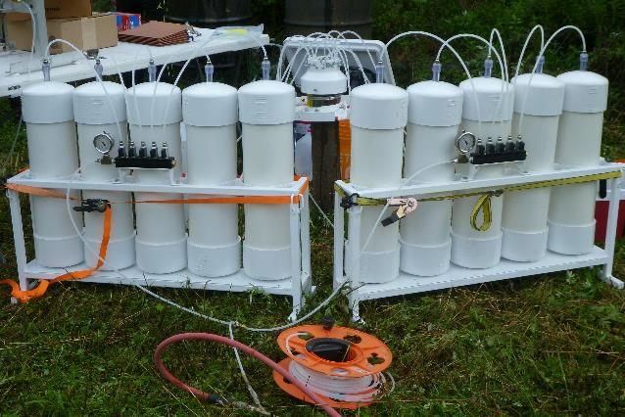
Thanks for your attention.
Questions?
FLUTe simultaneous purge apparatus used for the Aug 2017 water sampling

