Slide 1
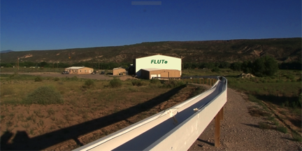
FLUTe™– Flexible Liner Underground Technologies
For a Medley of Innovative Designs
Derek Angel
Hydrogeologist

Slide 2
About Our Company
Established in 1996 by principal scientist Carl Keller
World wide distribution including all 50 US states, Puerto Rico, Europe, Asia, Africa, South America, and Australia
FLUTe systems have been installed at over 20 superfund sites and growing
FLUTe customers include:
US EPA, US Army Corps of Engineers, US Air Force, Boeing, ExxonMobil, Ford, GM, GE, Viacom, Shell, Chevron, and many more
ERM, AECOM, GZA, AMEC Foster Wheeler, Kleinfelder, Arcadis and many more
All FLUTe systems are fabricated in the USA at our Velarde, NM facility

Slide 3
Objectives of the FLUTe Method
Sealing Open Boreholes to Prevent Cross Contamination
Characterizing Bedrock Fracture Transmissivity and Head Distributions
In-Situ Contaminant Distribution Mapping-Free Product and Dissolved Phase
Multilevel Groundwater Monitoring Systems

Slide 4
What are FLUTe Liners?
Construction
Flexible sleeves of impermeable nylon fabric that are closed on one end.
Strength
Nylon 210 denier to 840 denier
Size
2 inch diameters to more than 30 inches.
Process
When pressurized with air, water, or mud, the liners seal to the interior of a borehole

Slide 5
How FLUTe Liners Work

Slide 6
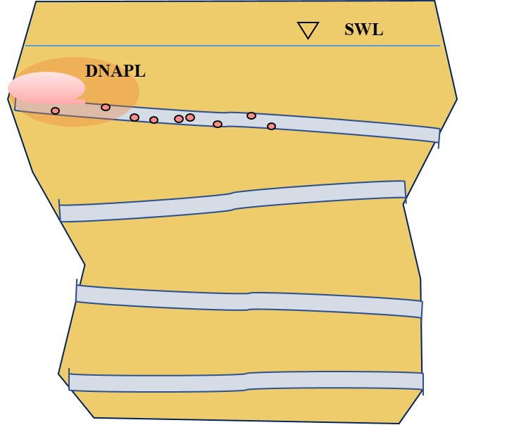
Why Seal a Borehole with a FLUTe Liner
Contamination as it exists in the formation
Cross Contamination after drilling

Slide 7
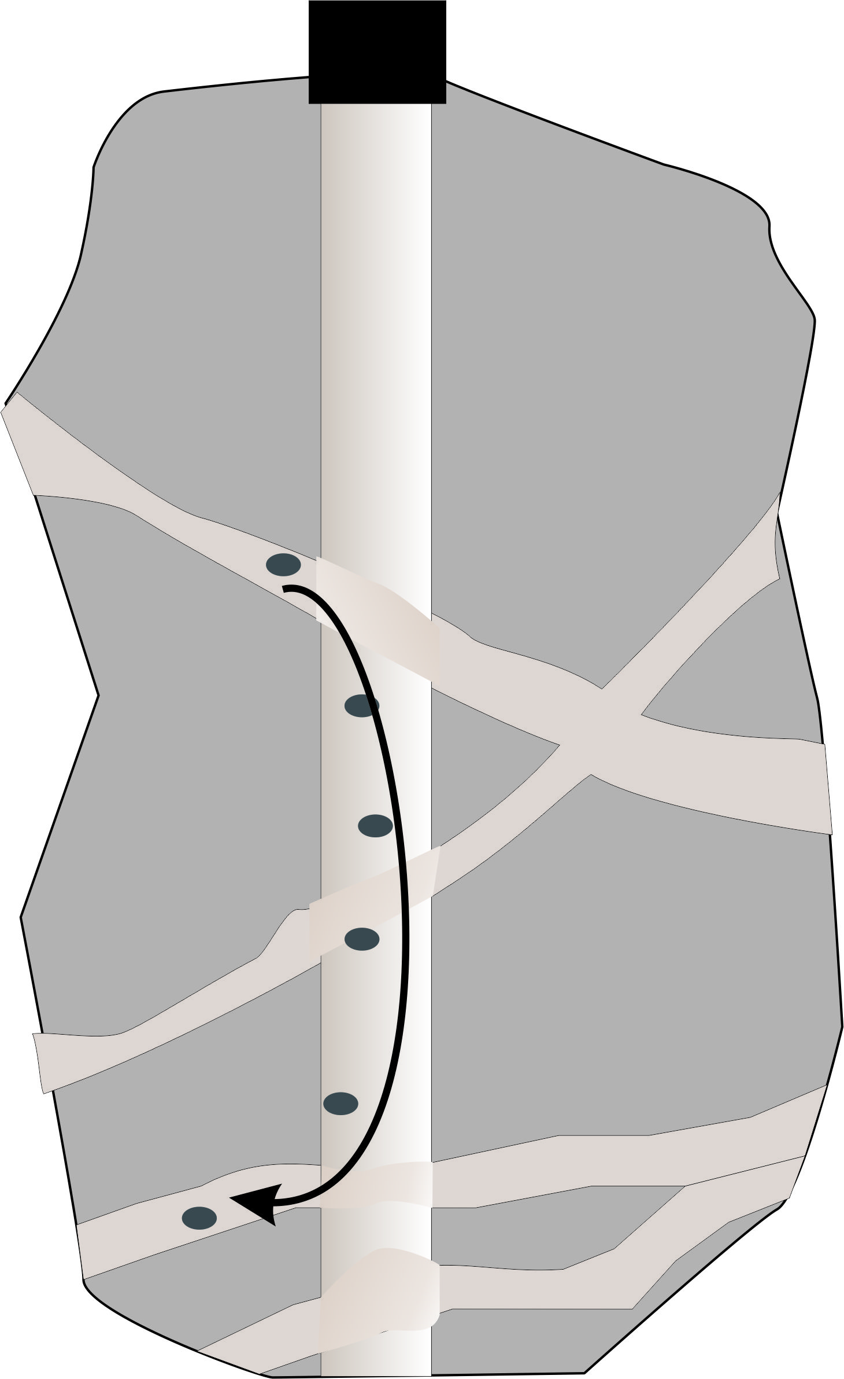
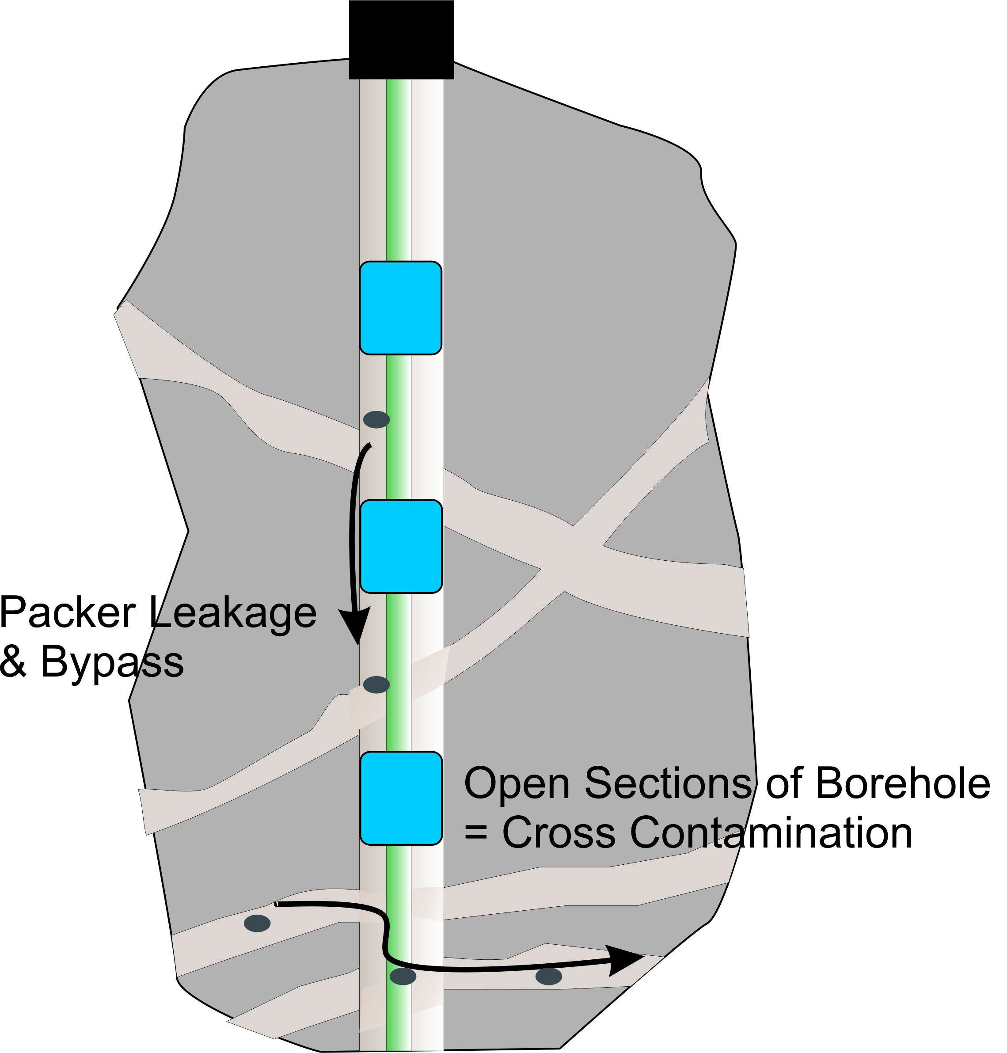
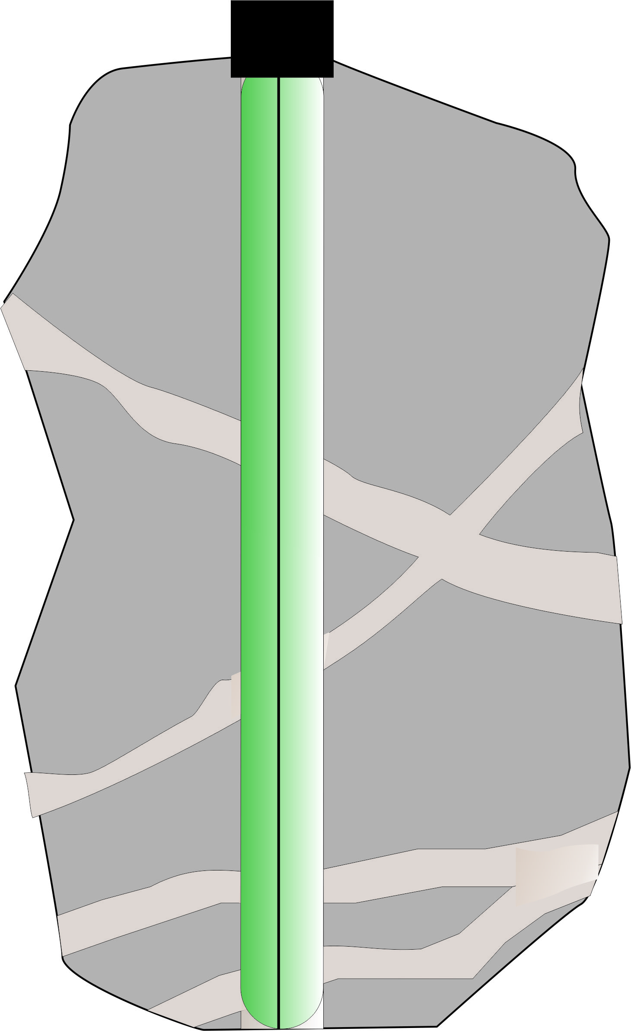
Traditional and Newer Methods
Packer Sealed Borehole
Cross Contamination Possible
FLUTe Liner
Fully Sealed Borehole-
Cross Contamination Not Possible
Open Borehole
Cross Contamination Likely
FLUTe Blank Liner Sealed to the Borehole Wall

Slide 8
FLUTe Liners Can Evert Through Many Turns and Angles

Slide 9
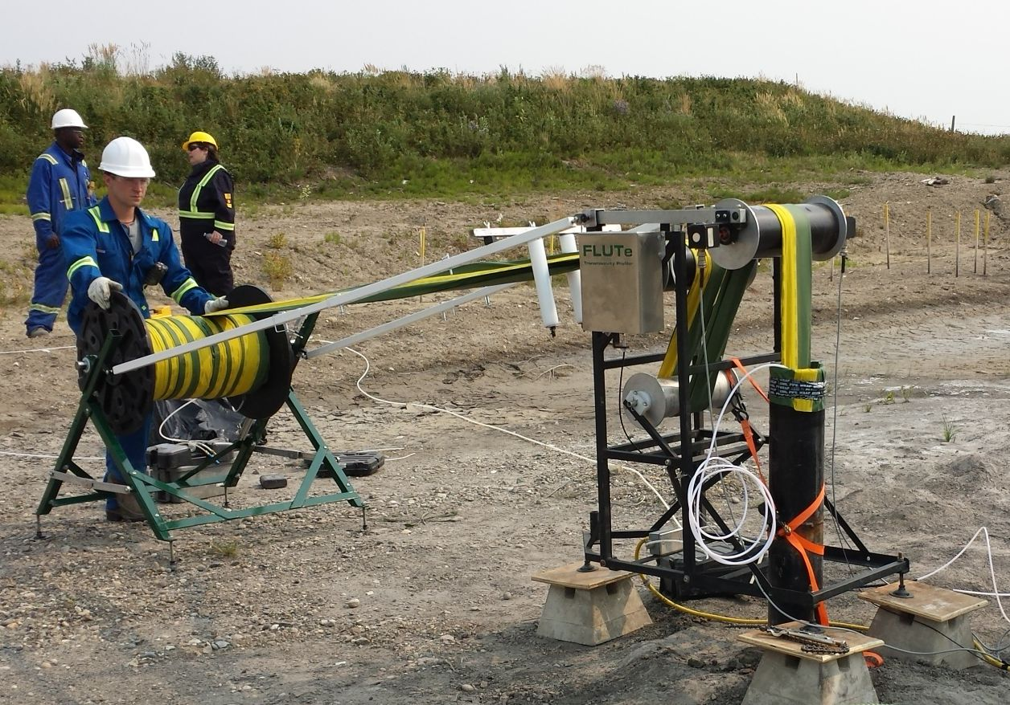
Questions about FLUTe methods ?
Everything we do is customizable, have a unique project? Contact us!
Email Derek@flut.com or call 860-436-7276

