Slide 1
Advantages of Simultaneous Purging and sampling
A FLUTe method of higher resolution
Carl Keller, carl@flut.com

Slide 2
Why? To avoid cross connection effects
Drilling introduces a path for immediate cross connection and also drives cross connection. –especially with recirculation of drilling fluids.
Open boreholes allow the spread of contamination to uncontaminated intervals of the formation
Therefore failure to remove the effects of cross connection leads to misleading ground water samples
This means that methods that do not allow purging of the cross connected fluids are often sampling the contaminated borehole water
Sealing a borehole is the obvious first defense
Any vertical gradient leads to vertical flow in an open borehole

Slide 3
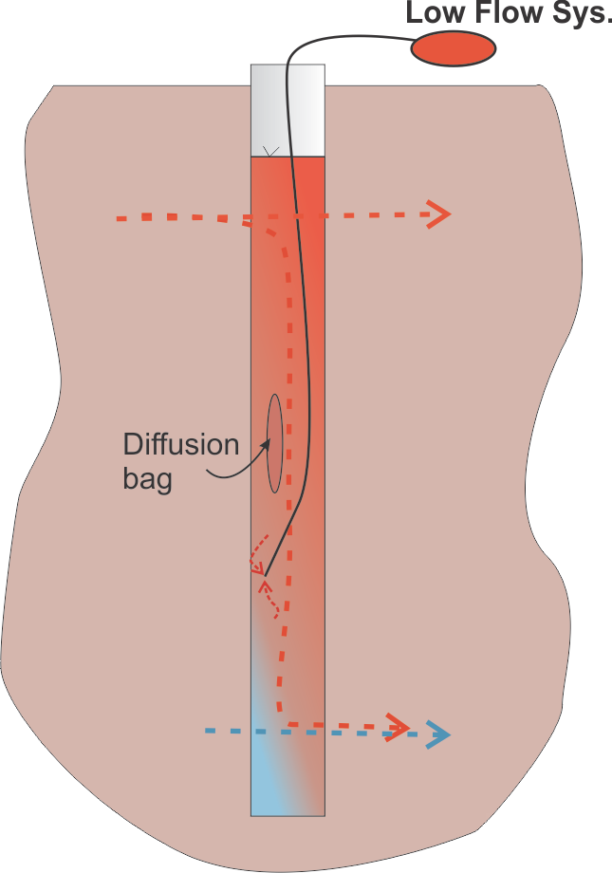
The worst case of cross connection: The wide open hole 1” of head over one ft. Intervale with T = 0.02cm²/s flows at 43 liters/day (1 ft of head difference => 500 l/day) flow rate in 6”x 200’ hole with 1” of head is 387,000 liters/day Therefore, whatever is the flow rate into or out of the hole is the cross connection rate.

Slide 4
Overlap of extraction intervals allows connection between sampling points

Slide 5
Straddle packers often sample borehole water

Slide 6
Simultaneous purge with equal drawdown in a sealed hole assures minimum cross connection adulteration of the formation water sample

Slide 7
Simultaneous purging can greatly reduce the time required to sample and improves the sample quality
With the Water FLUTe multi level sampling in a single borehole and simultaneous purging of the several ports using the FLUTe manifold, the time required to purge all ports is essentially the time required to purge a single port
The continuous borehole seal of the FLUTe systems avoids the bypass of packers in a borehole and the confusion of the borehole water sample
Any system which has no purge capability samples only borehole water and not the formation water. Even a sand packed sampling system often purges less than the sand pack pore volume and often slow, such as the low flow sampling method.
Sampling in the open borehole even with straddle packers is to maximize the sensitivity to cross connection because the standard 3 interval volumes are often much less than the cross connecting flow volume.

Slide 8
Conclusions:
Open boreholes spread contamination
Flow rates in open holes can be liters/day to 1000s of liters/day
Sampling in open boreholes with the several common devices is often not relevant to the formation contaminant distribution.
Sealing the borehole prevents cross connection
Sampling from a sealed borehole provides more useful contaminant distributions
Simultaneous purging assures even better spatial resolution of formation contamination
The Water FLUTe system offers simultaneous purging and sampling and the associated reduction of time in the field (see www.flut.com )

Slide 9
A unique application in a screened well
It is normally impractical to sample in a screened well to obtain a discrete formation sample due to the flow in the filter pack.
The simultaneous sampling in a screened well sealed with a liner allows practical vertical isolation in order to draw from the formation.

Slide 10
Using a straddle packer in a screened well provides no vertical isolation

Slide 11
How does one obtain the same drawdown when simultaneous sampling with a Water FLUTe?
While using the simultaneous purge manifold on all ports:
First expel the entire pump tube volume from each port.
Then, allow a fraction of the full recharge (e.g., 10%), then expel that water.
The refill in all ports is then at near the full drawdown of each pump for each port.
Expel the water from all pumps.
Allow again a fraction of the full recharge.
This pumping procedure is easily obtained with a common bladder pump driver set to the prescribed purge pressure and with a discrete recharge time.
Collect the total volume discharged from each port
The sample should be collected only after each port has expelled the prescribe purge volume while the other faster flowing ports are still being pumped.
This assures that each port is pumped at nearly the same draw down and the prescribed purge volume minimum has been extracted at each port

Slide 12
Thanks for your attention
Questions?
For more information on FLUTe methods: www.flut.com

